Slide 1
Life cycle of a software system:
Module - I
Software Design
Development
Testing
Deployment
Maintenance.

Slide 2
Producing a software application is relatively simple in concept: Take an idea and turn it in to a useful program.
Unfortunately for projects of any real scope, there are countless ways that a simple concept can go wrong.
Programmers may not understand what users want or need so they build the wrong application.

Slide 3
Requirements Gathering (Requirements Analysis)
Design
Development (coding)
Testing
Deployment (Implementation)
Maintenance

Slide 4
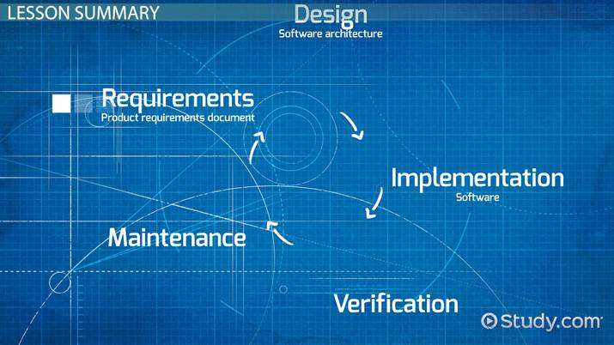

Slide 5
Requirements Gathering
No big project can succeed without a plan.
Sometimes a project doesn’t follow the plan closely, but every big project must have a plan.
The plan tells project members what they should be doing, when and how long they should be doing it, and most important what the project’s goals are.

Slide 6
They give the project direction.
One of the first steps in a software project is figuring out the requirements.
We need to find out what the customers want and what the customers need.
Depending on how well defined the user’s needs are, this can be time‐consuming.

Slide 7
Once the customers’ wants and needs are clearly specified, then we can turn them into requirements documents.
Those documents tell the customers what they will be getting, and they tell the project members what they will be building.
Throughout the project, both customers and team members can refer to the requirements to see if the project is heading in the right direction.

Slide 8
Requirements are the features that your application must provide.
At the beginning of the project, we gather requirements from the customers to figure out what we need to build.
Throughout development, we use the requirements to guide development and ensure that we are heading in the right direction.
At the end of the project, we use the requirements to verify that the finished application actually does what it’s supposed to do.

Slide 9
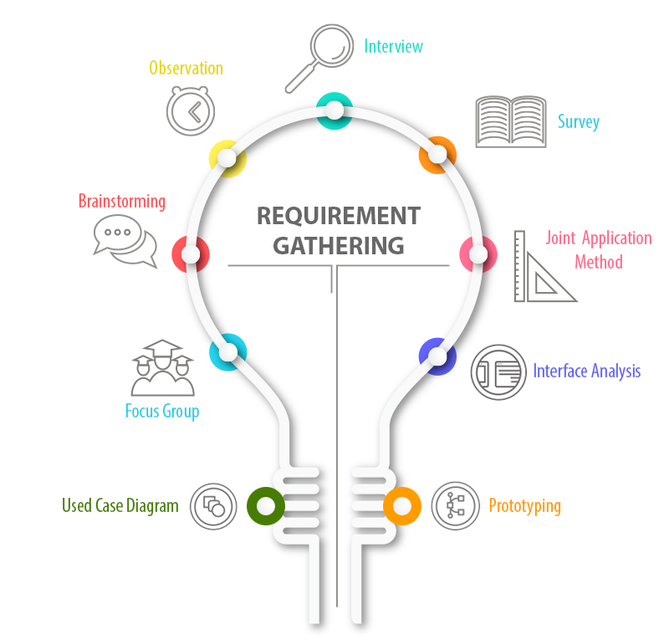

Slide 10
Characteristics of good requirements
Clear
  Good requirements are clear, concise, and easy to understand.
  requirements cannot be vague or ill‐defined.
  Each requirement must state in concrete
Unambiguous (not open to more than one interpretation)
  As we write requirements, do our best to make sure we can’t think of any way to interpret them other than the way we intend.
Notes:
Unambiguous- not open to more than one interpretation.

Slide 11
Consistent
  That means not only that they cannot contradict each other, but that they also don’t provide so many constraints that the problem is unsolvable.
  Each requirement must also be self‐consistent.(it must be possible to achieve.)
Prioritized
  We might like to include every feature but don’t have the time or budget, so something’s got to go. At this point, we need to prioritize the requirements.
Verifiable
  If we can’t verify a requirement, how do we know whether we have met it?
  Being verifiable means the requirements must be limited and precisely defined.

Slide 12
REQUIREMENT CATEGORIES
Audience‐Oriented Requirements:
These categories focus on different audiences and the different points of view that each audience has.
Business Requirements:
Business requirements layout the project’s high‐level goals.
User Requirements:
User requirements (which are also called stake holder requirements), describe how the project will be used by the end users.

Slide 13
Functional Requirements:
Functional requirements are detailed statements of the project’s desired capabilities.
Non-functional Requirements:
Non-functional requirements are statements about the quality of the application’s behavior or constraints on how it produces a desired result.
They specify things such as the application’s performance, reliability, and security characteristics.
Implementation Requirements:
Implementation requirements are temporary features that are needed to transition to using the new system but that will be later discarded.

Slide 14
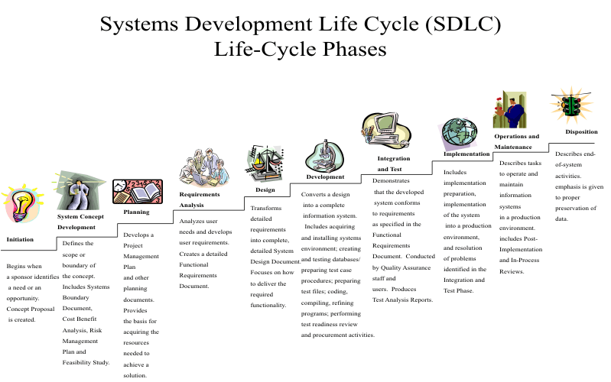

Slide 15
Design
Software design sits at the technical kernel of software engineering
The importance of design is quality
Design is the only way that you can accurately translate stakeholder’s requirements into a finished software product or system.
Software design is an iterative process through which requirements are translated into a “blueprint” for constructing the software

Slide 16
Quality Attributes
It is commonly known as FURPS.
  Functionality
  Usability
  Reliability
  Performance
  Supportability

Slide 17
Functionality is assessed by evaluating the feature set and capabilities of the program, the generality of the functions that are delivered, and the security of the overall system
Usability is assessed by considering human factors
Reliability is evaluated by measuring the frequency and severity of failure, the accuracy of output results, the ability to recover from failure
Performance is measured by considering processing speed, response time, resource consumption, throughput, and efficiency
Supportability combines the ability to extend the program (extensibility), adaptability, serviceability—these three attributes represent a more common term, maintainability

Slide 18
Design can be of two types:- high level design and low level design.
HIGH-LEVEL DESIGN
The high‐level design includes such things as decisions about what platform to use (such as desktop, laptop, tablet, or phone), what data design to use and the project architecture at a relatively high level.
We break the project into different modules that handle the project’s major areas of functionality.
We should make sure that the high‐level design covers every aspect of the requirements.
It should specify what the pieces(modules) do and how they should interact, but it should include as few details as possible about how the pieces do their jobs.

Slide 19
LOW‐LEVELDESIGN
After high‐level design breaks the project into pieces, we can assign those pieces to groups within the project so that they can work on low‐level designs.
The low‐level design includes information about how that piece of the project should work.
Better interactions between the different pieces of the project that may require changes here and there.
High‐level design focuses on what.
Low‐level design begins to focus on how.

Slide 20
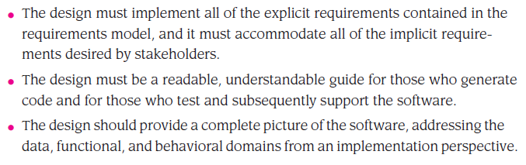
Three characteristics for a good design

Slide 21
Development
After we have created the high‐and low‐level designs, it’s time for the programmers to get to work.
The programmers continue refining the low‐level designs until they know how to implement those designs in code.
As the programmers write the code, they test it to make sure it doesn’t contain any bugs.

Slide 22
During the Development Phase, the system developer takes the detailed logical information documented in the previous phase and transforms it into machine-executable form, and ensures that all of the individual components of the automated system/application function correctly and interface properly with other components within the system/application.
The Development Phase includes several activities that are the responsibility of the developer.

Slide 23
Activities:-
The developer places the outputs under configuration control and performs change control.
The developer also documents and resolves problems and non-conformances found in the software products and tasks.
The developer selects, tailors, and uses those standards, methods, tools, and computer programming languages that are documented, appropriate, and established by the organization for performing the activities in the Development Phase.
Plans for conducting the activities of the Development Phase are developed, documented and executed. The plans include specific standards, methods, tools, actions, and responsibility associated with the development and qualification of all requirements including safety and security.
Verify that the software product covering the documented and baselined requirements in is a sufficient state of readiness for integration and formal testing by an assigned test group (i.e. other than development personnel.)
During the Development Phase, the final Test Plan is prepared.

Slide 24
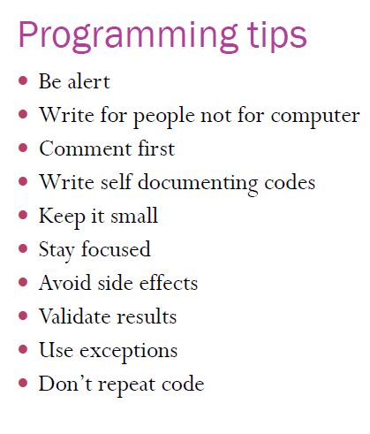

Slide 25
Testing
Effective software testing will improve software quality.
Even poorly planned and executed testing will improve software quality if it finds defects.
Testing is a life-cycle activity; testing activities begin from product inception and continue through delivery of the software and into maintenance.
Collecting bug reports and assigning them for repair is also a testing activity.
But as a life-cycle activity, the most valuable testing activities occur at the beginning of the project.

Slide 26
The terms error, bug, fault, and failure:-
Use of “bug” is that an error crept into the program through no one’s action. The preferred term for an error in requirement, design, or code is “error” or “defect.”
The manifestation of a defect during the operation of the software system is called a fault.
A fault that causes the software system to fail to meet one of its requirements is called a failure.

Slide 27
Purpose of Testing
Testing is the execution of a program or partial program with known inputs and outputs that are both predicted and observed for the purpose of finding faults or deviations from the requirements.
Testing will flush out errors, this is just one of its purposes.
The other is to increase trust in the system.
Testing must increase faith in the system, even though it may still contain undetected faults, by ensuring that the software meets its requirements.
A good test is one that has a high probability of finding an error. A successful test is one that uncovers an error.

Slide 28
Levels of Testing ( Types of Testing )
Unit testing:- Verifies the correctness of a specific piece of code
  Since unit test is the first chance to catch errors, it is extremely important
  Focus on each unit (eg: component, class or web App content object) of the software as implemented in the source code.
  sometimes called desk checking.

Slide 29
Black Box Testing
In black box testing, only inputs and outputs of the unit are considered; how the outputs are generated based on a particular set of inputs is ignored.
Some widely used black box testing techniques include:
  Exhaustive testing
  Boundary value testing
  Random test generation
  Worst case testing

Slide 30
Brute force or exhaustive testing involves presenting each code unit with every possible input combination.
  Brute force testing can work well in the case of a small number of inputs each with a limited input range
Boundary value or corner case testing solves the problem of combinatorial explosion by testing some very tiny subset of the input combinations identified as meaningful “boundaries” of input.

Slide 31
Random test case generation, or statistically based testing, can be used for both unit and system level testing.
  This kind of testing involves subjecting the code unit to many randomly generated test cases over some period of time.
  The purpose of this approach is to simulate execution of the software under realistic conditions.

Slide 32
Equivalence class testing involves partitioning the space of possible test inputs to a code unit or group of code units into a set of representative inputs.

Slide 33
White Box Testing
White box testing (sometimes called clear or glass box testing) seeks to test the structure of the underlying code. For this reason it is also called structural testing.
Black box tests are data driven, White box tests are logic driven.
White box testing are designed to exercise all paths in the code unit.
White box testing also has the advantage that it can discover those code paths that cannot be executed.

Slide 34
Integration Testing:-
Integration testing involves testing of groups of components integrated to create a system or sub-system.
The tests are derived from the system specification.
Verifies that a block of code is working properly
It checks that the existing code calls the new method correctly, and that new method can call other methods correctly.

Slide 35
Incremental Integration Testing:- This is a strategy that partitions the system in some way to reduce the code tested. Incremental testing strategy includes:
  Top-Down Testing
  Bottom-Up Testing
  Other kinds of system partitioning
  In practice, most integration involves a combination of these strategies.

Slide 36
  Top-Down Testing - This kind of testing starts with a high-level system and integrates from the topdown, replacing individual components by stubs (dummy programs) where appropriate.
  Bottom-Up Testing - Bottom up testing is the reverse of top-down testing in which we integrate individual components in levels, from the bottom up, until the complete system is created.
  Other kinds of system partitioning - These include pair-wise integration, sandwich integration, neighbourhood,integration testing, and interface testing.

Slide 37
Regression testing:- Test the program's entire functionality to see if any thing changed when you added new code to the project.
  Regression testing (which can also be performed at the unit level) is used to validate the updated software against the old set of test cases that have already been passed.
  Regression testing helps to ensure that changes (due to testing or for other reasons) do not introduce unintended behavior or additional errors.

Slide 38
Acceptance testing:- Determine whether the finished application meets the customer’s requirements.
  Usually customer or representative sits down with the application and runs through all the user cases (during requirement analysis) to make sure everything works as advertised.
  Most software builders use a process called alpha and beta testing to uncover errors that only the end user able to find.

Slide 39
Alpha test:-
    First round testing by selected customers or independent testers.
    version of the complete software is tested by customer under the supervision of the developer at the developer’s site
Beta test:-
    Second round testing after alpha test.
    version of the complete software is tested by customer at his or her own site without the developer being present.

Slide 40
Automated testing:- Automated testing tools let you define tests and the results they should produce.
  After running a test, the testing tool can compare the results it got with expected results.
System testing:- End to end run through of the whole system.
  System test exercise every part of the system to discover as many bugs as possible.

Slide 41
Performance Testing: test the run-time performance of software within the context of an integrated system
Deployment testing(configuration testing): exercises the software in each environment in which it is to operate. It also examines the installation procedures and installation software.
Recovery testing: forces the software to fail in a variety of ways and verifies that recovery is properly performed.

Slide 42
Deployment
What is deployment?
  Getting software out of the hands of the developers into the hands of the users.
The software is delivered to the customer who evaluates the delivered product and provides feedback based on the evaluation.

Slide 43
Key issues around deployment
Business processes:- Most large software systems require the customer to change the way they work.
Training:- No point in deploying software if the customers can't use it.
Deployment itself:- How physically to get the software installed.
Equipment:- Is the customer's hardware up to the job?
Expertise:- Does the customer have the IT expertise to install the software?
Integration:- can it be integrated with other systems of the customer.

Slide 44
Maintenance
The software product will enter a maintenance mode after delivery in which it will experience many recurring life cycles as errors are detected and corrected and features are added.
The process of changing a system after it has been delivered.
Software maintenance is the “…correction of errors, and implementation of modifications needed to allow an existing system to perform new tasks, and to perform old ones under new conditions”
Notes:
Slew: to slide violently… uncontrollable sliding movement

Slide 45
As soon as the users start pounding away on our software, they will find bugs.
Of course, when the users find bugs, we need to fix them.
Fixing a bug sometimes leads to another bug, so now we get to fix that one as well.
The software maintenance phase activities generally consist of a series of reengineering processes to prolong the life of the system.

Slide 46
Re-engineering:- is the process of taking an old or un-maintainable system and transforming it until it's maintainable.
If our application is successful, users will use it a lot, and they’ll be even more likely to find bugs. They also think up of enhancements, improvements, and new features that they want added immediately.

Slide 47
